Slide 1
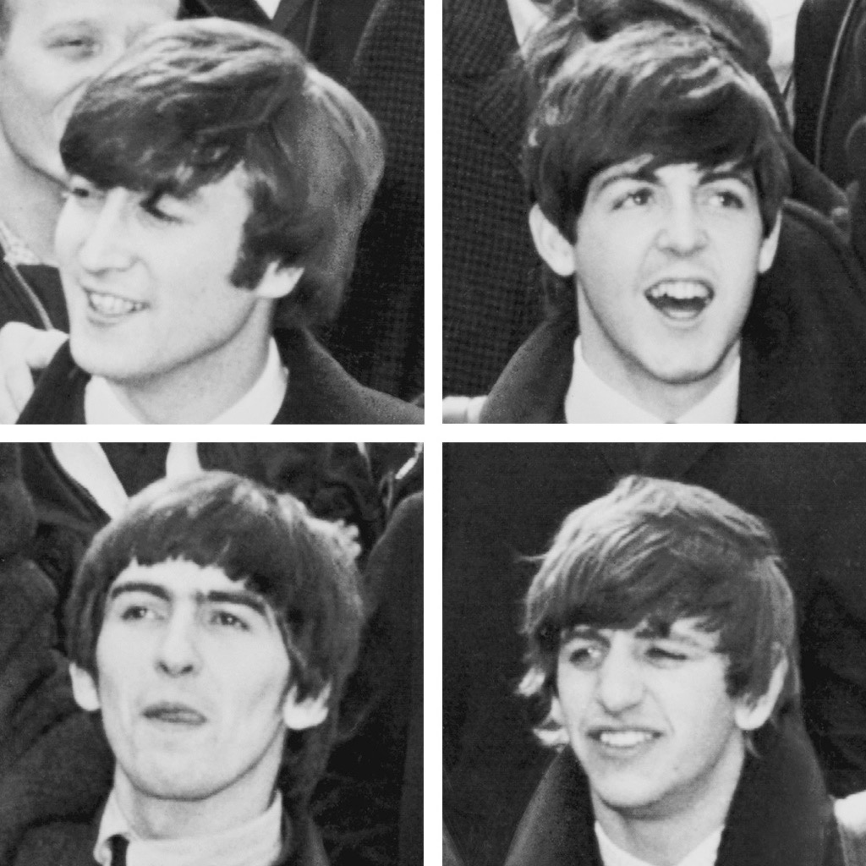
The Beatles

Slide 2
The Beatles were formed in 1960, in _________, England.
Liverpool

Slide 3
The classic Beatles line up was: ___________,
______________,
______________,
and __________.
John Lennon
Paul McCartney
George Harrison
Ringo Starr

Slide 4
All four members contributed vocals, but it was the song writing of ______ and __________ which was most influential.
Lennon
McCartney

Slide 5
Their appearance on the Ed Sullivan show is credited as starting the ______________, an influential period in rock and roll history.
British Invasion

Slide 6
Frenzied fan reactions to the Beatles was known as ____________.
Beatlemania

Slide 7
Do you think the music of the Beatles is still relevant today? Why, or why not?

Slide 8
How can you compare the reaction of fans to the Beatles in the 1960’s with the reaction of fans towards their favourite artists today?

Slide 9
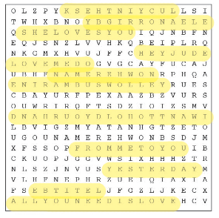
Beatles Songs Word Search
1 . Lucy in the sky (with diamonds)
2. Eleanor Rigby
3. She Loves You
4. Hey Jude
5. Love Me Do
6. Nowhere Man
7. Yellow Submarine
8. I Want To Hold Your Hand
9. From Me to You
10. Yesterday
11. Let it Be
12. All You Need is Love

